Slide 1

Lecture-5
Database Management system:
Normalization & Functional Dependencies
Topics:
Anomalies in unnormalized relations.
1NF, 2NF, 3NF, BCNF.
Functional Dependency, Transitive Dependency.
Activity: Normalize a given table step by step.

Slide 2

What is Normalization ?
NORMALIZATION is a database design technique that organizes tables in a manner that reduces redundancy and dependency of data.
Normalization divides larger tables into smaller tables and links them using relationships.
The purpose of Normalization is to eliminate redundant (useless) data and ensure data is stored logically.
The inventor of the relational model E.F.Codd proposed the theory of normalization.

Slide 3
Redundancy
Row Level Redundancy:
If the SID is primary key to each row, you can use it to remove the duplicates as shown below:
SID | SName | Age
1 | Jojo | 20
2 | Kit | 25
1 | Jojo | 20
SID | SName | Age
1 | Jojo | 20
2 | Kit | 25

Slide 4
Redundancy (Cont..)
Column Level Redundancy:
Now Rows are same but in column level because of Sid is primary key but columns are same.
Redundant Column Values
Sid | Sname | Cid | Cname | Fid | Fname | Salary
1 | AA | C1 | DBMS | F1 | Jojo | 30000
2 | BB | C2 | JAVA | F2 | KK | 50000
3 | CC | C1 | DBMS | F1 | Jojo | 30000
4 | DD | C1 | DBMS | F1 | Jojo | 30000

Slide 5
What is an Anomaly?
Problems that can occur in poorly planned, unnormalized databases where all the data is stored in one table (a flat-file database).
Types of Anomalies:
• Insert
• Delete
• Update

Slide 6
Anomalies in DBMS
Insert Anomaly : An Insert Anomaly occurs when certain attributes cannot be inserted into the database without the presence of other attributes.
Delete Anomaly: A Delete Anomaly exists when certain attributes are lost because of the deletion of other attributes.
Update Anomaly: An Update Anomaly exists when one or more instances of duplicated data is updated, but not all.

Slide 7
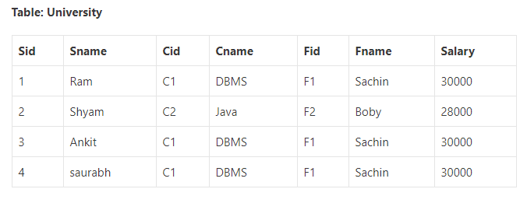
Anomaly Example
Below table University consists of seven attributes: Sid, Sname, Cid, Cname, Fid, Fname, and Salary. And the Sid acts as a key attribute or a primary key in the relation.

Slide 8
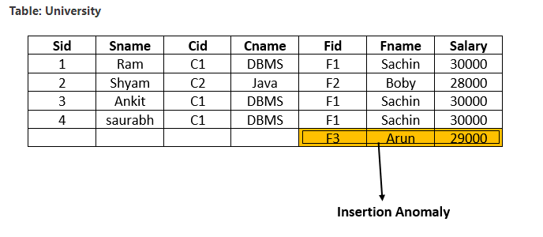
Insertion Anomaly
Suppose a new faculty joins the University, and the Database Administrator inserts the faculty data into the above table. But he is not able to insert because Sid is a primary key, and can’t be NULL. So this type of anomaly is known as an insertion anomaly.

Slide 9
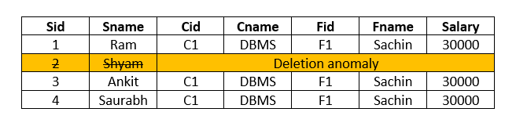
Delete Anomaly
When the Database Administrator wants to delete the student details of Sid=2 from the above table, then it will delete the faculty and course information too which cannot be recovered further.
SQL:
DELETE FROM University WHERE Sid=2;

Slide 10
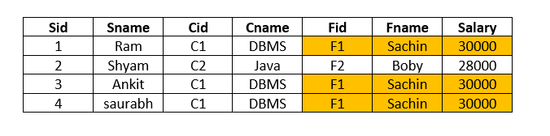
Update Anomaly
When the Database Administrator wants to change the salary of faculty F1 from 30000 to 40000 in above table University, then the database will update salary in more than one row due to data redundancy. So, this is an update anomaly in a table.
SQL:
UPDATE University SET Salary= 40000 WHERE Fid=“F1”;
To remove all these anomalies, we need to normalize the data in the database.

Slide 11
Normal forms
The Theory of Data Normalization in SQL is still being developed further. For example, there are discussions even on 6th Normal Form. However, in most practical applications, normalization achieves its best in 3rd Normal Form. The evolution of Normalization theories is illustrated below-

Slide 12
First Normal Form (1NF)
According to the E.F. Codd, a relation will be in 1NF, if each cell of a relation contains only an atomic value.

Slide 13
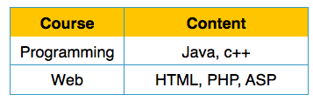
1NF Example
Example:
The following Course_Content relation is not in 1NF because the Content attribute contains multiple values.

Slide 14
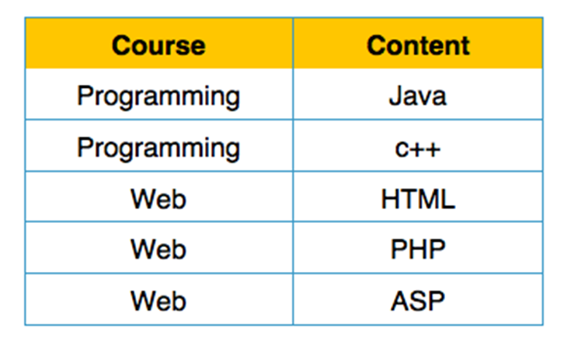
1NF Example (Cont..)
The below relation student is in 1NF:

Slide 15
Rules of 1NF
The official qualifications for 1NF are:
Each attribute name must be unique.
Each attribute value must be single.
Each row must be unique.
Additional:
Choose a primary key.
Reminder:
A primary key is unique, not null, unchanged. A primary key can be either an attribute or combined attributes.

Slide 16
Second Normal Form (2NF)
According to the E.F. Codd, a relation is in 2NF, if it satisfies the following conditions:
The table should be in the First Normal Form.
There should be no Partial Dependency.

Slide 17
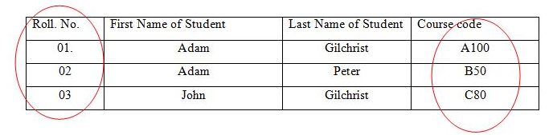
Prime and Non Prime Attributes
Prime attributes: The attributes which are used to form a candidate key are called prime attributes.
Non-Prime attributes: The attributes which do not form a candidate key are called non-prime attributes.
Prime Attribute: Roll No., Course Code
Non-Prime Attribute: First Name of Student, Last Name of Student

Slide 18
Functional Dependency
A dependency FD: X → Y means that the values of Y are determined by the values of X. Two tuples sharing the same values of X will necessarily have the same values of Y.
We illustrate this as:
X→ Y (read as: X determines Y or Y depends on X)

Slide 19
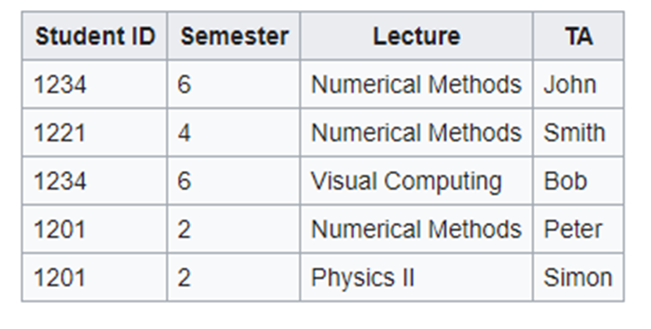
Functional Dependency
Whenever two rows in this table feature the same StudentID, they also necessarily have the same Semester values. This basic fact can be expressed by a functional dependency:
StudentID → Semester.

Slide 20
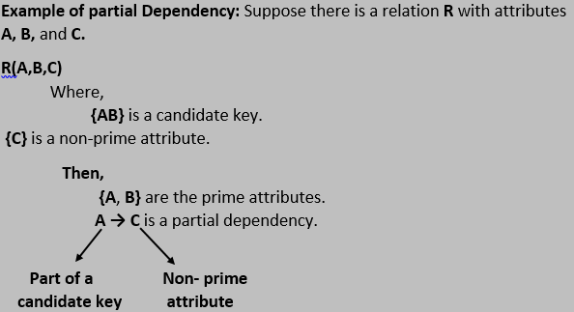
Partial Dependency
If a non-prime attribute can be determined by the part of the candidate key in a relation, it is known as a partial dependency.

Slide 21
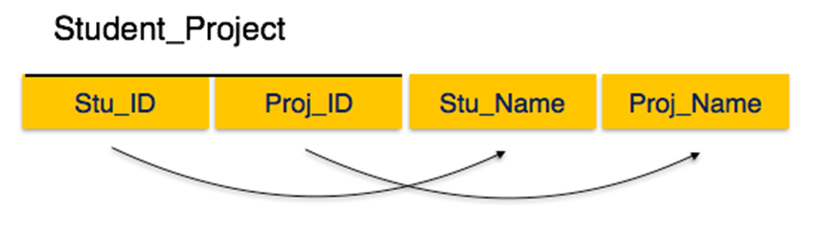
2NF Example
In Student_Project relation that the prime key attributes are Stu_ID and Proj_ID.
According to the rule, non-key attributes, i.e. Stu_Name and Proj_Name must be dependent upon both and not on any of the prime key attribute individually.
But we find that Stu_Name can be identified by Stu_ID and Proj_Name can be identified by Proj_ID independently. This is called partial dependency, which is not allowed in Second Normal Form.
Candidate Keys: {Stu_ID, Proj_ID}
Non-prime attribute: Stu_Name, Proj_Name

Slide 22
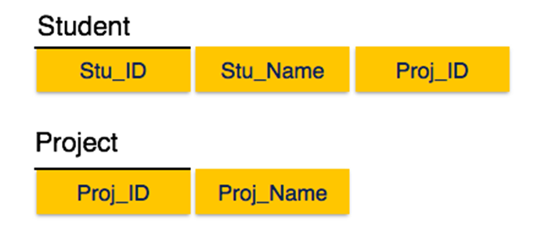
2NF Example (Cont..)
We broke the relation in two as depicted in the above picture. So there exists no partial dependency.

Slide 23

Example 2NF
The Course Name depends on only CourseID, a part of the primary key not the whole primary {CourseID, SemesterID}.It’s called partial dependency.
Solution:
Remove CourseID and Course Name together to create a new table.

Slide 24

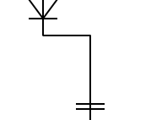
Example 2NF (Cont..)
CourseID | SemesterID | Num Student
IT101 | 201301 | 25
IT101 | 201302 | 25
IT102 | 201301 | 30
IT102 | 201302 | 35
IT103 | 201401 | 20
Done? Oh no, it is still not in 1NF yet. Remove the repeating groups too.
Finally, connect the relationship.
CourseID | Course Name
IT101 | Database
IT102 | Web Prog
IT103 | Networking

Slide 25
Third Normal Form (3NF)
According to the E.F. Codd, a relation is in third normal form (3NF) if it satisfies the following conditions:
It should be in the Second Normal form.
It should not have Transitive Dependency.
All transitive dependencies are removed to place in another table.

Slide 26
Transitive Dependency
A functional dependency is said to be transitive if it is indirectly formed by two functional dependencies. For e.g.
X -> Z is a transitive dependency if the following three functional dependencies hold true:
X->Y
Y does not ->X
Y->Z

Slide 27
Transitive Dependency(Cont..)
Let’s take an example to understand it better:
{Book} ->{Author} (if we know the book, we knows the author name)
{Author} does not ->{Book}
{Author} -> {Author_age}
Therefore as per the rule of transitive dependency: {Book} -> {Author_age} should hold, that makes sense because if we know the book name we can know the author’s age.
Book | Author | Author_age
Windhaven | George R. R. Martin | 66
Harry Potter | J. K. Rowling | 49
Dying of the Light | George R. R. Martin | 66

Slide 28
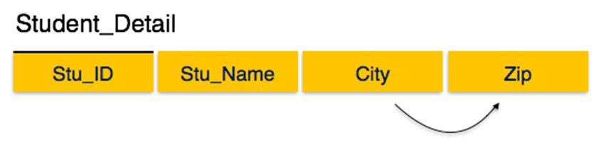
3NF Example
We find that in the above Student_detail relation, Stu_ID is the key and only prime key attribute.
We find that City can be identified by Stu_ID as well as Zip itself.
Neither Zip is a superkey nor is City a prime attribute. Additionally, Stu_ID → Zip → City, so there exists transitive dependency.
Candidate Key: {Stu_ID}
Prime attribute: Stu_ID
Non-prime attribute: {Stu_Name, City, Zip}

Slide 29
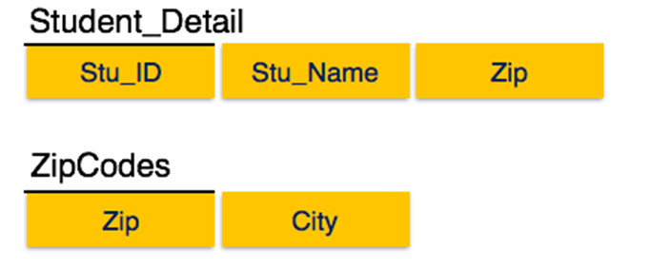
3NF Example (Cont..)
To bring this relation into third normal form, we break the relation into two relations as follows −

Slide 30
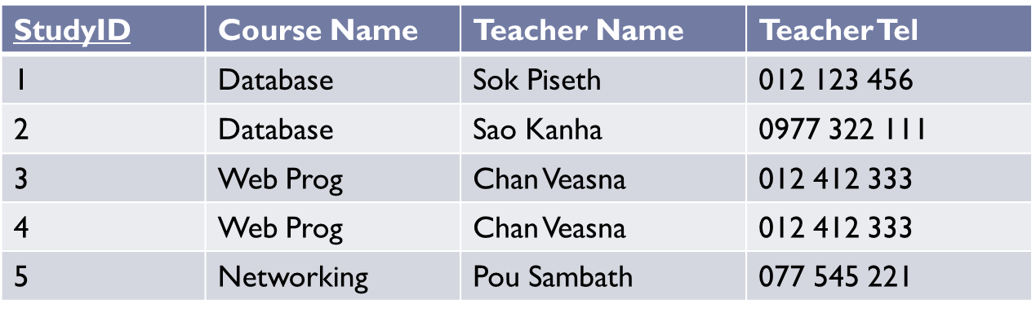


Example 3NF
The Teacher Tel is a nonkey attribute, and the Teacher Name is also a nonkey atttribute.
But Teacher Tel depends on Teacher Name.
It is called transitive dependency.
Solution:
Remove Teacher Name and Teacher Tel together to create a new table.

Slide 31
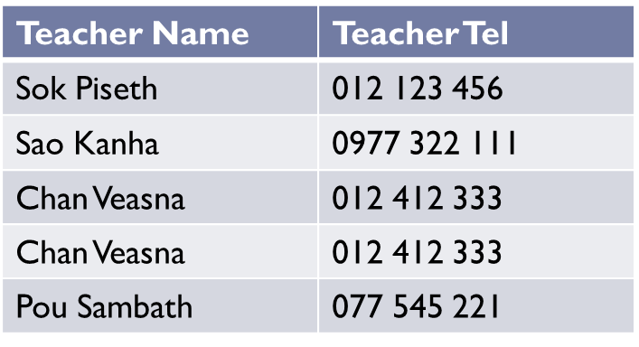
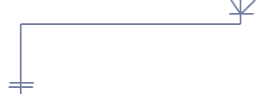
Example 3NF
StudyID | Course Name | T.ID
1 | Database | T1
2 | Database | T2
3 | Web Prog | T3
4 | Web Prog | T3
5 | Networking | T4
Done? Oh no, it is still not in 1NF yet. Remove Repeating row.
ID | Teacher Name | Teacher Tel
T1 | Sok Piseth | 012 123 456
T2 | Sao Kanha | 0977 322 111
T3 | Chan Veasna | 012 412 333
T4 | Pou Sambath | 077 545 221
Note about primary key:
In theory, you can choose Teacher Name to be a primary key.
But in practice, you should add Teacher ID as the primary key.

Slide 32

Example Table
StudentID is the primary key.
Is it 1NF?
How can you make it 1NF?

Slide 33

Example 1 (Cont..)
Create new rows so each cell contains only one value
But now the studentID no longer uniquely identifies each row. You now need to declare studentID and subject together to uniquely identify each row. So the new key is StudentID and Subject.
Is it 2NF?

Slide 34
Example 1 (Cont..)
Studentname and address are dependent on studentID (which is part of the key) This is good. But they are not dependent on Subject (the other part of the key)
And 2NF requires…
All non-key fields are dependent on the ENTIRE key (studentID + subject)

Slide 35
Example 1 (Cont..)
Make new tables
Make a new table for each primary key field
Give each new table its own primary key
Move columns from the original table to the new table that matches their primary key…

Slide 36
Boyce-Codd Normal Form (BCNF)
BCNF does not allow dependencies between attributes that belong to candidate keys.
BCNF is a refinement of the third normal form in which it drops the restriction of a non-key attribute from the 3rd normal form.
Third normal form and BCNF are not same if the following conditions are true:
The table has two or more candidate keys
At least two of the candidate keys are composed of more than one attribute
The keys are not disjoint i.e. The composite candidate keys share some attributes
Example 1 - Address (Not in BCNF)
Scheme → {City, Street, ZipCode }
Key1 → {City, Street }
Key2 → {ZipCode, Street}
No non-key attribute hence 3NF
{City, Street} → {ZipCode}
{ZipCode} → {City}
Dependency between attributes belonging to a key

Slide 37
Boyce Codd Normal Form (BCNF)
Example 2 - Movie (Not in BCNF)
Scheme → {MovieTitle, MovieID, PersonName, Role, Payment }
Key1 → {MovieTitle, PersonName}
Key2 → {MovieID, PersonName}
Both role and payment functionally depend on both candidate keys thus 3NF
{MovieID} → {MovieTitle}
Dependency between MovieID & MovieTitle Violates BCNF
Example 3 - Consulting (Not in BCNF)
Scheme → {Client, Problem, Consultant}
Key1 → {Client, Problem}
Key2 → {Client, Consultant}
No non-key attribute hence 3NF
{Client, Problem} → {Consultant}
{Client, Consultant} → {Problem}
Dependency between attributess belonging to keys violates BCNF

Slide 38
BCNF - Decomposition
Place the two candidate primary keys in separate entities
Place each of the remaining data items in one of the resulting entities according to its dependency on the primary key.
Example 1 (Convert to BCNF)
Old Scheme → {City, Street, ZipCode }
New Scheme1 → {ZipCode, Street}
New Scheme2 → {City, Street}
Loss of relation {ZipCode} → {City}
Alternate New Scheme1 → {ZipCode, Street }
Alternate New Scheme2 → {ZipCode, City}

Slide 39
Decomposition – Loss of Information
If decomposition does not cause any loss of information it is called a lossless decomposition.
If a decomposition does not cause any dependencies to be lost it is called a dependency-preserving decomposition.
Any table scheme can be decomposed in a lossless way into a collection of smaller schemas that are in BCNF form. However the dependency preservation is not guaranteed.
Any table can be decomposed in a lossless way into 3rd normal form that also preserves the dependencies.
3NF may be better than BCNF in some cases
Use your own judgment when decomposing schemas

Slide 40
BCNF - Decomposition
Example 2 (Convert to BCNF)
Old Scheme → {MovieTitle, MovieID, PersonName, Role, Payment }
New Scheme → {MovieID, PersonName, Role, Payment}
New Scheme → {MovieTitle, PersonName}
Loss of relation {MovieID} → {MovieTitle}
New Scheme → {MovieID, PersonName, Role, Payment}
New Scheme → {MovieID, MovieTitle}
We got the {MovieID} → {MovieTitle} relationship back
Example 3 (Convert to BCNF)
Old Scheme → {Client, Problem, Consultant}
New Scheme → {Client, Consultant}
New Scheme → {Client, Problem}

Slide 41
Fourth Normal Form (4NF)
Fourth normal form eliminates independent many-to-one relationships between columns.
To be in Fourth Normal Form,
a relation must first be in Boyce-Codd Normal Form.
a given relation may not contain more than one multi-valued attribute.
Example (Not in 4NF)
Scheme → {MovieName, ScreeningCity, Genre)
Primary Key: {MovieName, ScreeningCity, Genre)
All columns are a part of the only candidate key, hence BCNF
Many Movies can have the same Genre
Many Cities can have the same movie
Violates 4NF
Movie
ScreeningCity
Genre
Hard Code
Los Angles
Comedy
Hard Code
New York
Comedy
Bill Durham
Santa Cruz
Drama
Bill Durham
Durham
Drama
The Code Warrier
New York
Horror

Slide 42
Fourth Normal Form (4NF)
Example 2 (Not in 4NF)
Scheme → {Manager, Child, Employee}
Primary Key → {Manager, Child, Employee}
Each manager can have more than one child
Each manager can supervise more than one employee
4NF Violated
Example 3 (Not in 4NF)
Scheme → {Employee, Skill, ForeignLanguage}
Primary Key → {Employee, Skill, Language }
Each employee can speak multiple languages
Each employee can have multiple skills
Thus violates 4NF
Manager
Child
Employee
Jim
Beth
Alice
Mary
Bob
Jane
Mary
NULL
Adam
Employee
Skill
Language
1234
Cooking
French
1234
Cooking
German
1453
Carpentry
Spanish
1453
Cooking
Spanish
2345
Cooking
Spanish

Slide 43
4NF - Decomposition
Move the two multi-valued relations to separate tables
Identify a primary key for each of the new entity.
Example 1 (Convert to 3NF)
Old Scheme → {MovieName, ScreeningCity, Genre}
New Scheme → {MovieName, ScreeningCity}
New Scheme → {MovieName, Genre}
Movie
Genre
Movie
ScreeningCity
Hard Code
Comedy
Hard Code
Los Angles
Bill Durham
Drama
Hard Code
New York
The Code Warrier
Horror
Bill Durham
Santa Cruz
Bill Durham
Durham
The Code Warrier
New York

Slide 44
4NF - Decomposition
Example 2 (Convert to 4NF)
Old Scheme → {Manager, Child, Employee}
New Scheme → {Manager, Child}
New Scheme → {Manager, Employee}
Example 3 (Convert to 4NF)
Old Scheme → {Employee, Skill, ForeignLanguage}
New Scheme → {Employee, Skill}
New Scheme → {Employee, ForeignLanguage}
Manager
Child
Manager
Employee
Jim
Beth
Jim
Alice
Mary
Bob
Mary
Jane
Mary
Adam
Employee
Skill
Employee
Language
1234
Cooking
1234
French
1453
Carpentry
1234
German
1453
Cooking
1453
Spanish
2345
Cooking
2345
Spanish

Slide 45
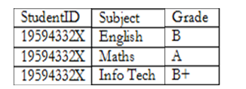

Example (Cont..)
STUDENT TABLE (key = StudentID)
RESULTS TABLE (key = StudentID+Subject) SUBJECTS TABLE (key = Subject)
But is it 3NF?

Slide 46
Example 1 (Cont..)
HouseName is dependent on both StudentID + HouseColour
Or
HouseColour is dependent on both StudentID + HouseName
But either way, non-key fields are dependent on MORE THAN THE PRIMARY KEY (studentID). And 3NF says that non-key fields must depend on nothing but the key

Slide 47
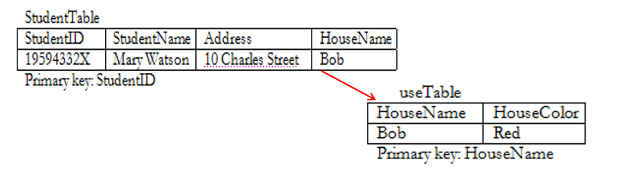
Example 1 (Cont..)

Slide 48
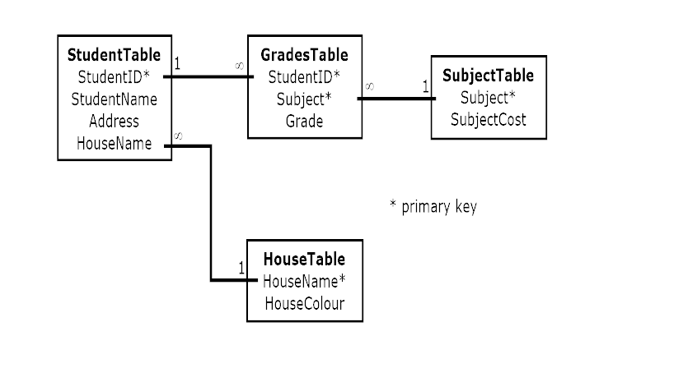
Example 1 (Cont..)
The Final Scheme

Slide 49
Example 2
We will use the Student_Grade_Report table below, from a School database, as our example to explain the process for 1NF.
Student_Grade_Report (StudentNo, StudentName, Major, CourseNo, CourseName, InstructorNo, InstructorName, InstructorLocation, Grade)

Slide 50
Process for 1NF
In the Student Grade Report table, the repeating group is the course information. A student can take many courses.
Remove the repeating group. In this case, it’s the course information for each student.
Identify the PK for your new table.
The PK must uniquely identify the attribute value (StudentNo and CourseNo).
After removing all the attributes related to the course and student, you are left with the student course table (StudentCourse).
The Student table (Student) is now in first normal form with the repeating group removed.
The two new tables are shown below:
Student (StudentNo, StudentName, Major)
StudentCourse (StudentNo, CourseNo, CourseName, InstructorNo, InstructorName, InstructorLocation, Grade)

Slide 51
Example 2 (Cont..)
Student (StudentNo, StudentName, Major)
StudentCourse (StudentNo, CourseNo, CourseName, InstructorNo, InstructorName, InstructorLocation, Grade)
To move to 2NF, a table must first be in 1NF.
The Student table is already in 2NF because it has a single-column PK.
When examining the Student Course table, we see that not all the attributes are fully dependent on the PK; specifically, all course information. The only attribute that is fully dependent is grade.
Identify the new table that contains the course information.
Identify the PK for the new table.
The three new tables are shown below.

Slide 52
Example 2 (Cont..)
Student (StudentNo, StudentName, Major)
CourseGrade (StudentNo, CourseNo, Grade)
CourseInstructor (CourseNo, CourseName, InstructorNo, InstructorName, InstructorLocation)

Slide 53
Process for 3NF
Eliminate all dependent attributes in transitive relationship(s) from each of the tables that have a transitive relationship.
Create new table(s) with removed dependency.
Check new table(s) as well as table(s) modified to make sure that each table has a determinant and that no table contains inappropriate dependencies.
See the four new tables below.

Slide 54
Process for 3NF
Student (StudentNo, StudentName, Major)
CourseGrade (StudentNo, CourseNo, Grade)
Course (CourseNo, CourseName, InstructorNo)
Instructor (InstructorNo, InstructorName, InstructorLocation)

Slide 55
Process for 3NF
At this stage, there should be no anomalies in third normal form.
Student (StudentNo, StudentName, Major)
StudentCourse (StudentNo, CourseNo, CourseName, InstructorNo, InstructorName, InstructorLocation, Grade)

Slide 56
END

